Slide 1

Yelp Customer Review Analysis
Leveraging Text Analytics to Facilitate Business Growth
~ DJH Analytics
Hedan Chen
Jingjing Li
Jingyi Yun
Dongni Yang
Daniel Zhang
Dingyi Zhou

Slide 2

Overview
1
2
3
4
Business Implication &
Team Introduction
Data Source & Exploratory Analysis
Methodologies & Model Comparison
Conclusion & Next Step

Slide 3

Yelp.com
“Yelp connects people with great local businesses”
A San Francisco based platform
Users can leave reviews for restaurants and other businesses
Each review consists of a star rating from 1-5, and an explanatory paragraph
Yelp has accumulated more than 155 Million reviews

Slide 4

Current Status
Desired Outcome
3.5 stars on Yelp
2819 reviews
5 stars on Yelp
We help improve the performance of businesses by designing an NLP-powered decision-making process
Food
Price
Service
Clean
Location

Slide 5






DJH Analytics
Daniel Zhang
Jingyi Yun
Jingjing Li
Business Analyst
Data Analyst
Marketing Analyst
Director
Data Engineer
Data Scientist
Hedan Chen
Dongni Yang
Dingyi Zhou

Slide 6

Data Source
The dataset is a subset of Yelp's businesses and reviews data containing information about businesses across 11 metropolitan areas in the USA and Canada. It’s available as JSON files, for use in personal, educational, and academic purposes.
1
2
Data Source
Data Volume
Yelp open data on Kaggle
6,990,280 reviews & 150,346 businesses &
200,100 pictures & 11 metropolitan areas
Connected by Business ID
4
3
Data Files
Data Format
Business / Review
User / Checkin / Tip / Photo
Each file is composed of a single object type, one JSON-object per-line
Data Source Link: https://www.kaggle.com/yelp-dataset/yelp-dataset

Slide 7
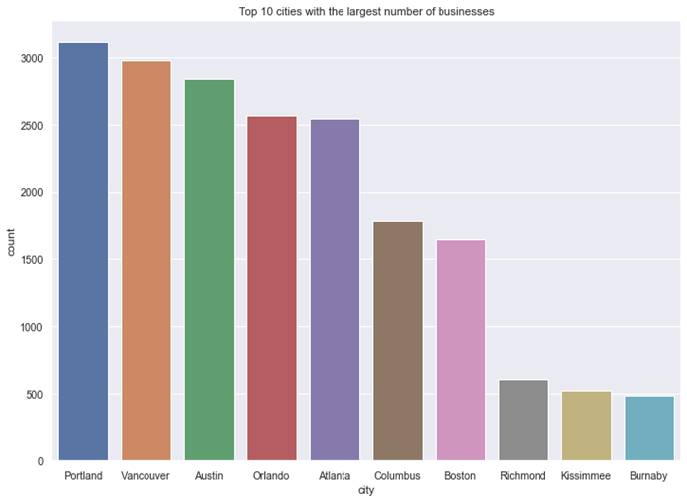
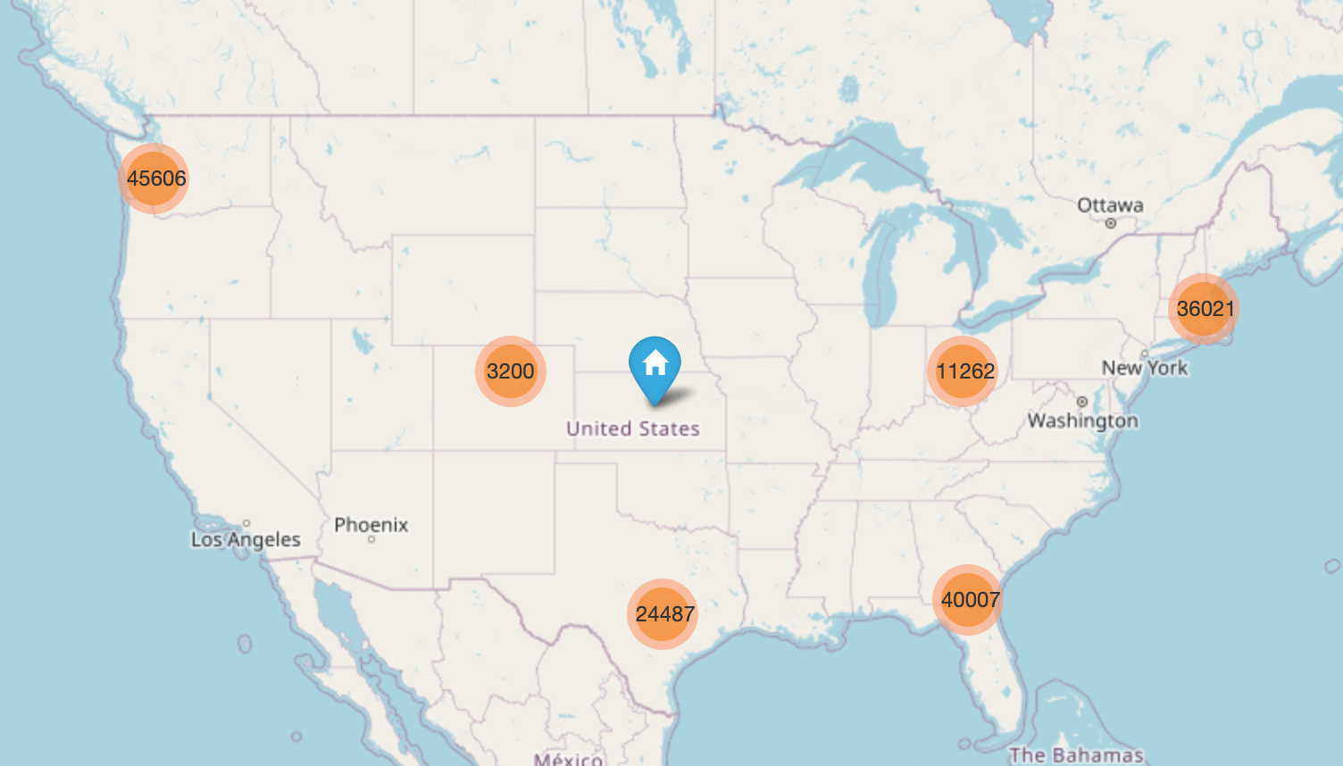
EDA – Geographic Distribution

Slide 8
EDA – Data Cleaning and Feature Transformation
Select businesses which are restaurant
Select businesses that are in top5 cities
(50793 rows × 14 columns).
(12658 rows × 14 columns).
Original Business Data
Drop businesses which are closed now
Encode & create new features
(160585 rows × 14 columns).
(32049 rows × 14 columns).
(12658 rows × 73 columns).

Slide 9
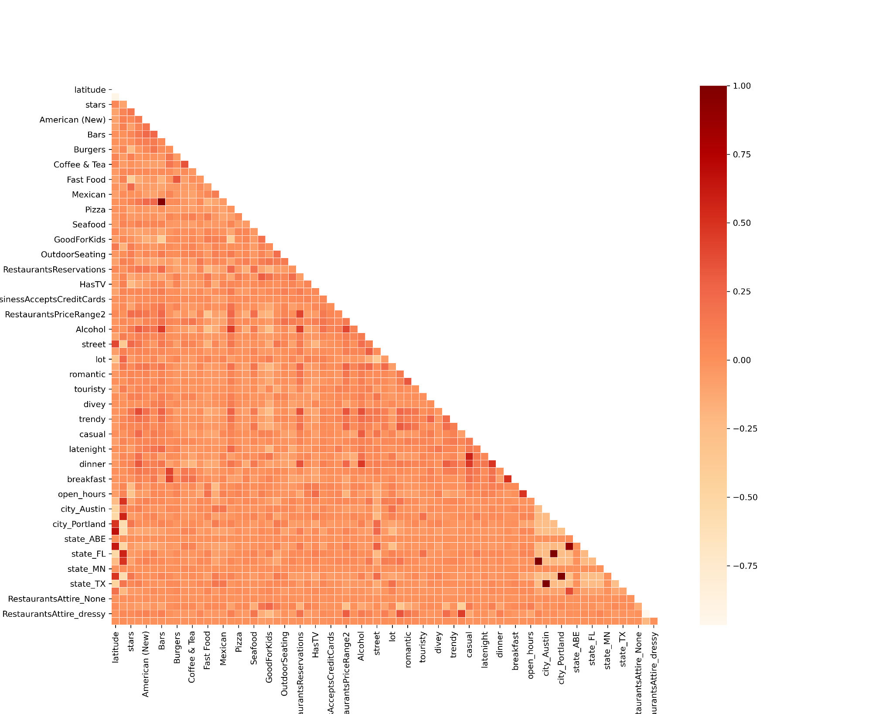
Dimension Reduction
Delete highly correlated features: mainly between “state” and “city”
Try various dimension reduction techniques. Evaluate using results from subsequent supervised model.
Since our dataset is very sparse, truncatedSVD gives best result. Need to keep 48 principal components to maintain 90% variance

Slide 10
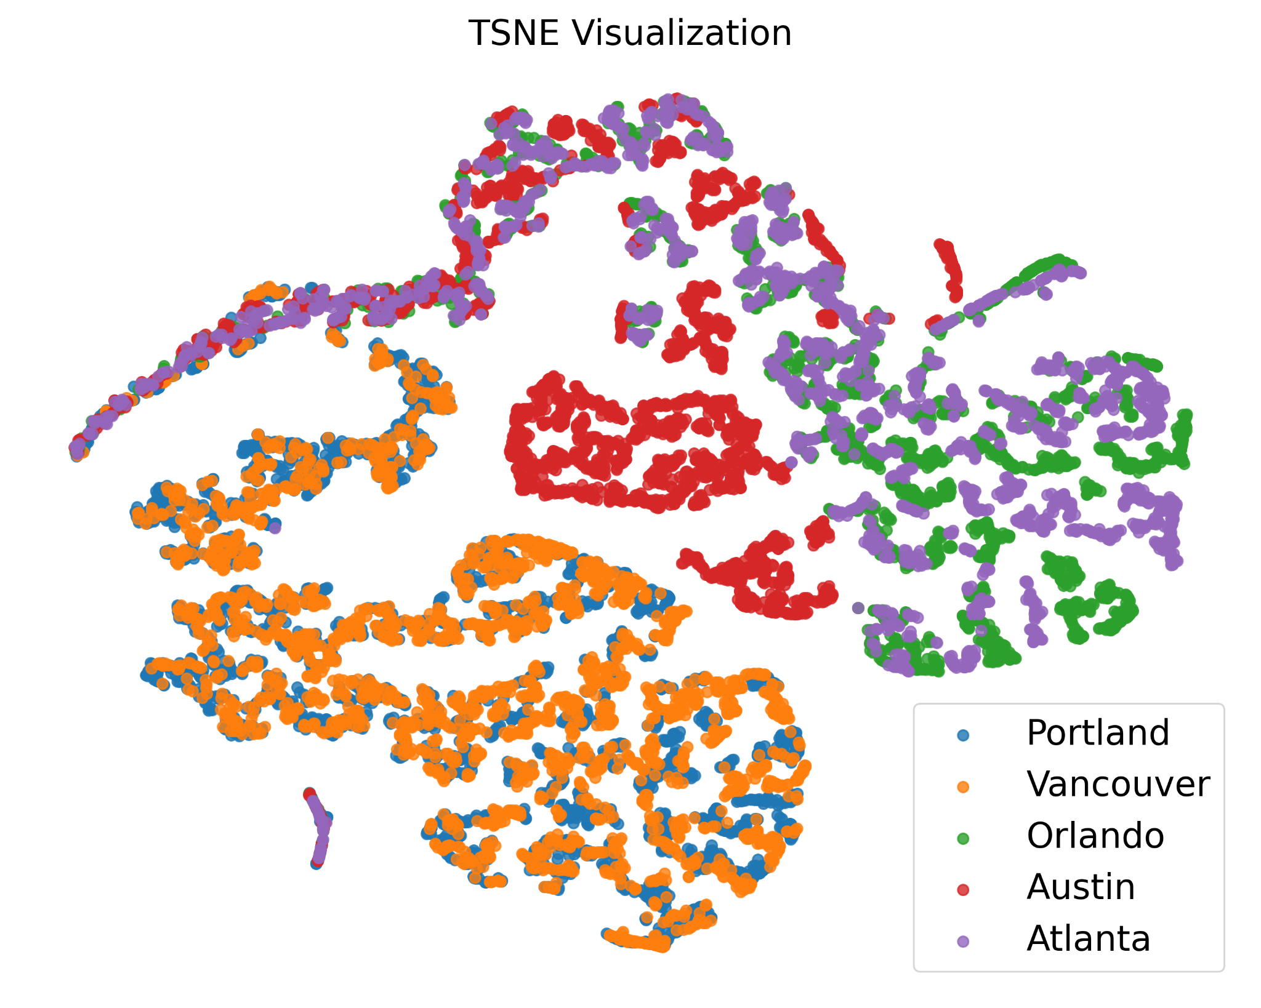
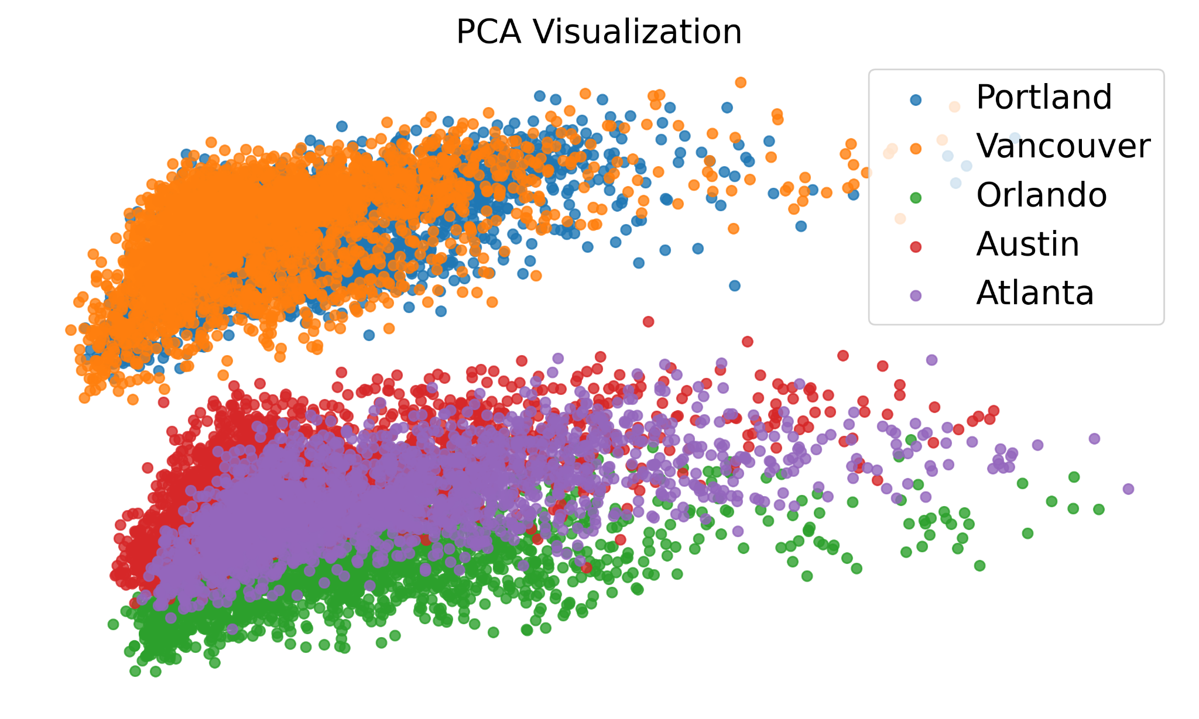
Visualization Before Clustering
Both PCA and TSNE tell the same story: Portland and Vancouver are overlapping, and Orlando, Atlanta, Austin are overlapping.
Also, cities within one group are close to each other in geography.
Clustering
Choose methods that are scalable with large samples:
K-Means
Agglomerative clustering
DBSCAN

Slide 11
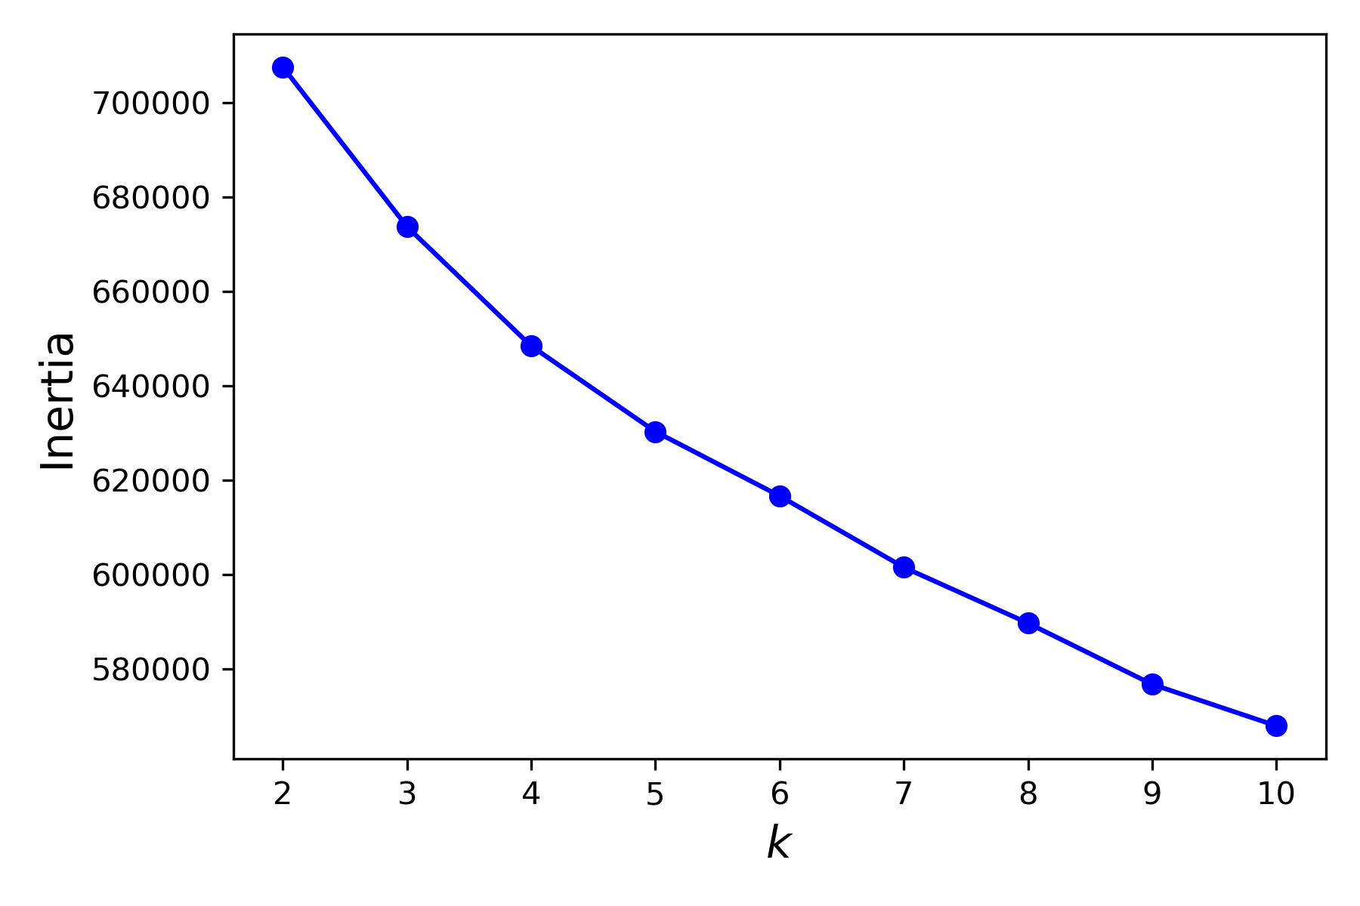
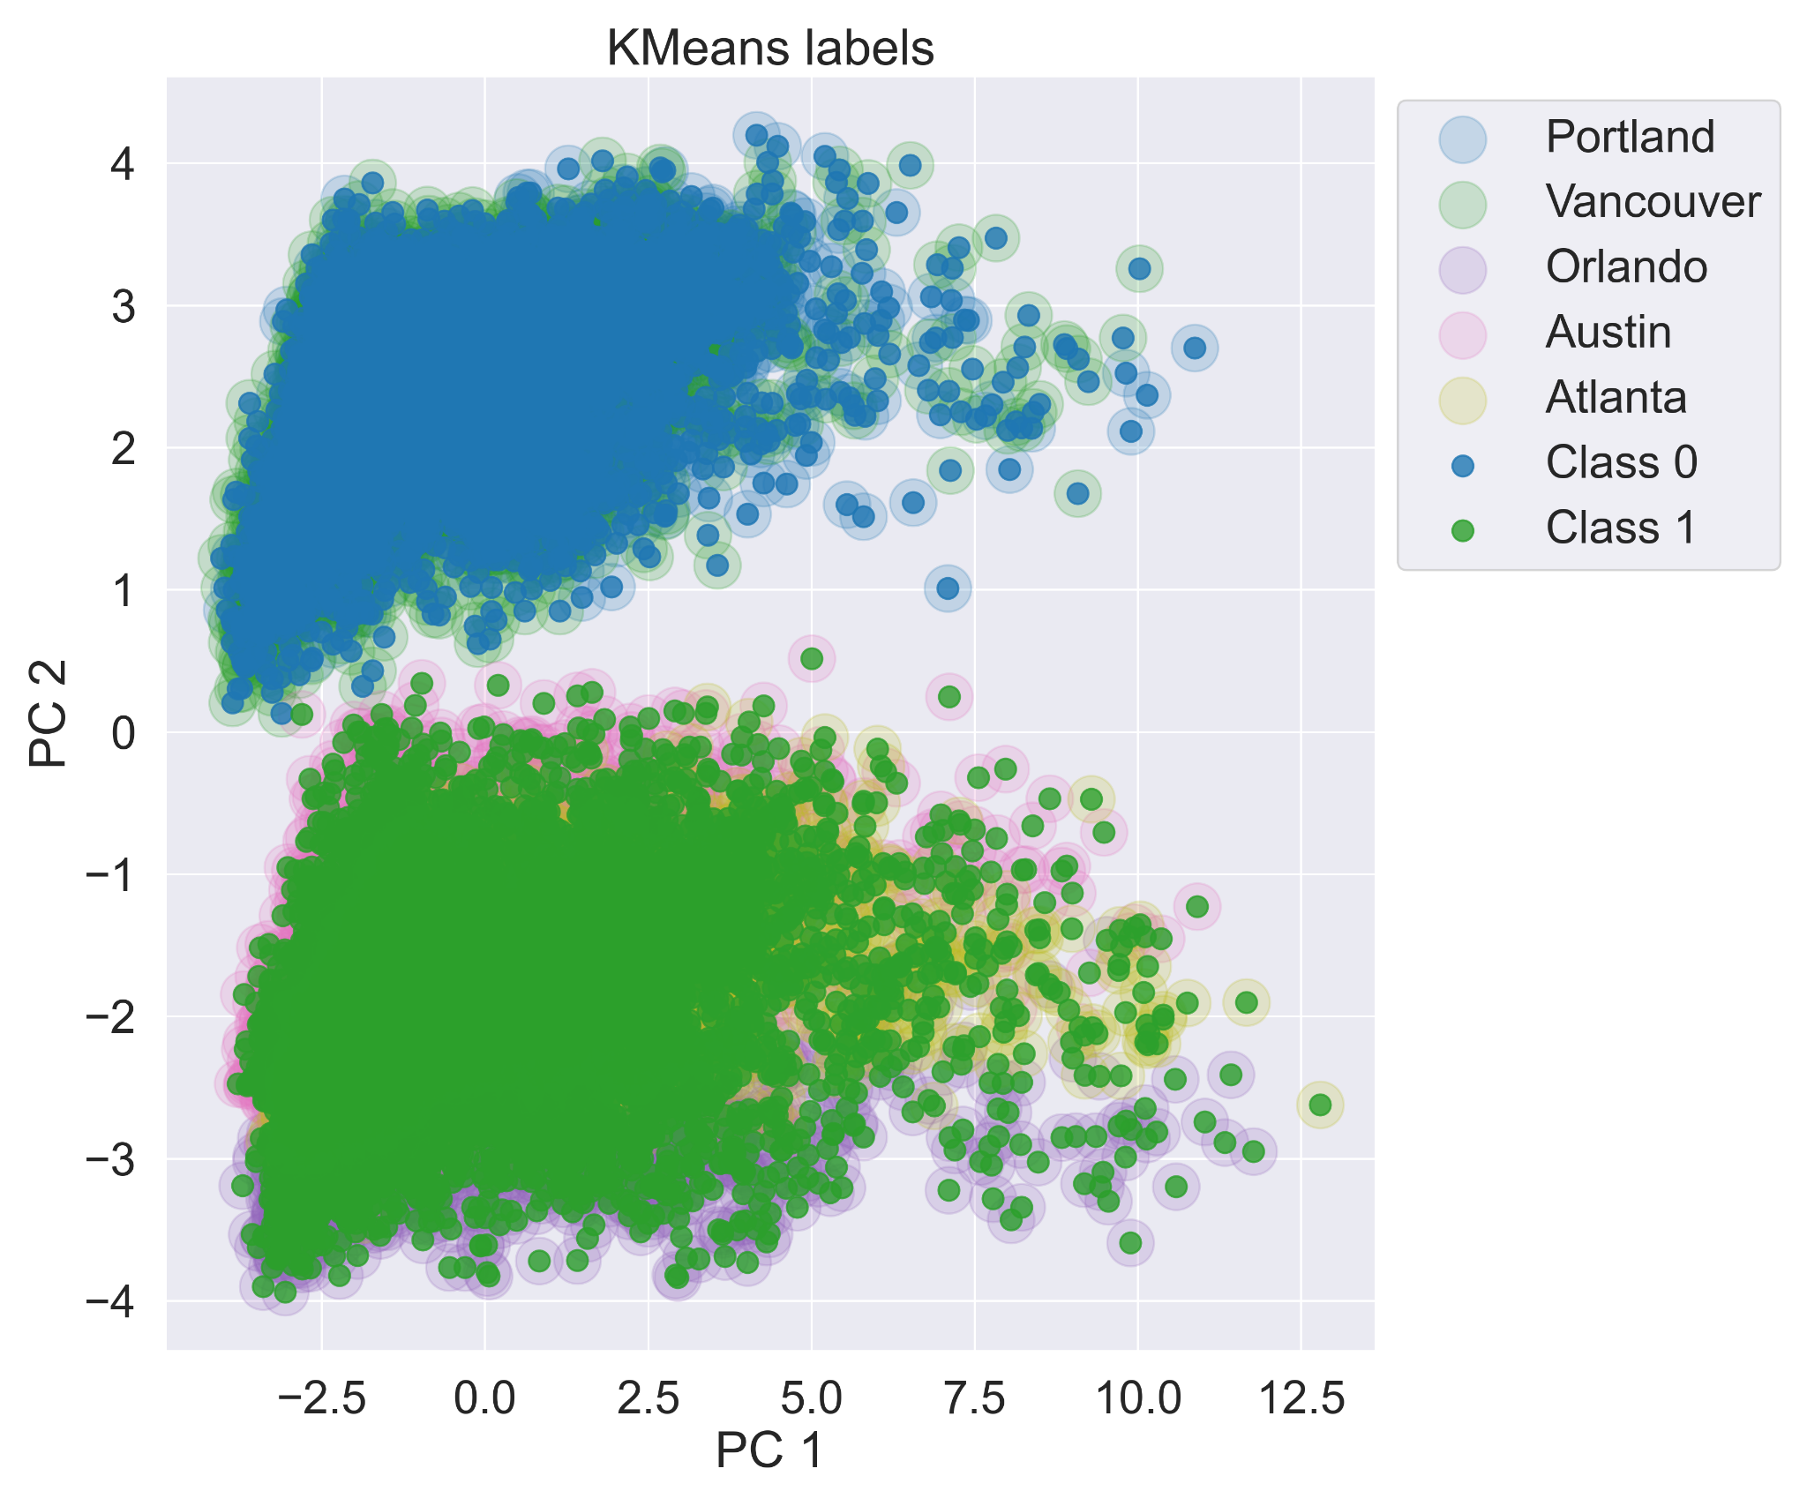
K Means Result
Number of Clusters | Silhouette Score
3 | 0.0748
2 | 0.0697
5 | 0.0664
7 | 0.0641
From Elbow method: inertia score keeps decreasing, but we don’t want to form too many cluster. We try to form 2 or 3 clusters by looking at silhouette score.
Find when number of cluster = 2:
Cluster 1 exactly comprised of Portland and Vancouver and Cluster 2 = Orlando + Austin + Atlanta
 | Within cluster | Between cluster | Define good | Distance
Inertia Score | √ | X | Not normalized, 0 is the best | Between centroids
Silhouette Coefficient | √ | √ | Between -1 and 1, 1 is the best | Between all other points

Slide 12
Machine Learning Text Analytics Pipeline
Text Raw Data
Stratified Sampling & Aspect Evaluation
Apply Stratified Sampling to reduce computational requirement
Perform Feature Engineering to select key aspects
ABSA based on BERT
Run NLP model to extract customer’s sentiment score on selected aspects
Core Model
Model Testing &
Model Comparation
Test the models with existing customer ratings
Compare performances of several models
Result
Acquire results to Present Recommendations to businesses

Slide 13
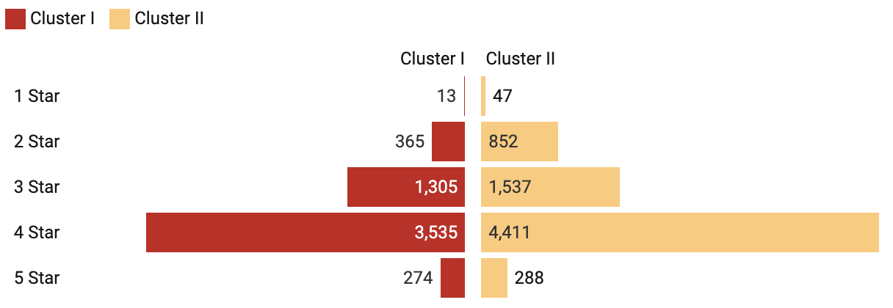
Stratified Sampling Based on Rating
Number of Reviews (N)
N > 10
Calculate the proportion of review counts of distinct stars
N <= 10
Retain all reviews
Calculate number of reviews to be drawn for each star so that the total is 10 (for an existing star, keep at least 1 review)
For each restaurant

Slide 14
Feature Engineering – Aspect Selection
Food
Food is defined as being appropriate for consumption in restaurant (Peri, 2006).
Service
Service refers to the judgment of customers regarding the delivered performance, that is, “magnitude and direction of discrepancy between perception and expectations of the consumers” (Jamal et al., 2009).
Price
From the consumer’s perspective, price is what the customer pays or gives for obtaining the product or service. Fairness of price is a psychological factor that plays an important role in the customer’s reaction to the paid price (Kim et al., 2006).
Clean
Data shows that consumers were already aware of cleanliness in eating out before pandemic, therefore, cleanliness is the priority for the restaurant make people come back after Covid-19 (News Desk, 2020).
Location
Restaurant location is an important feature of the restaurant that affects customer behavior and satisfaction (Hyun, 2010).

Slide 15
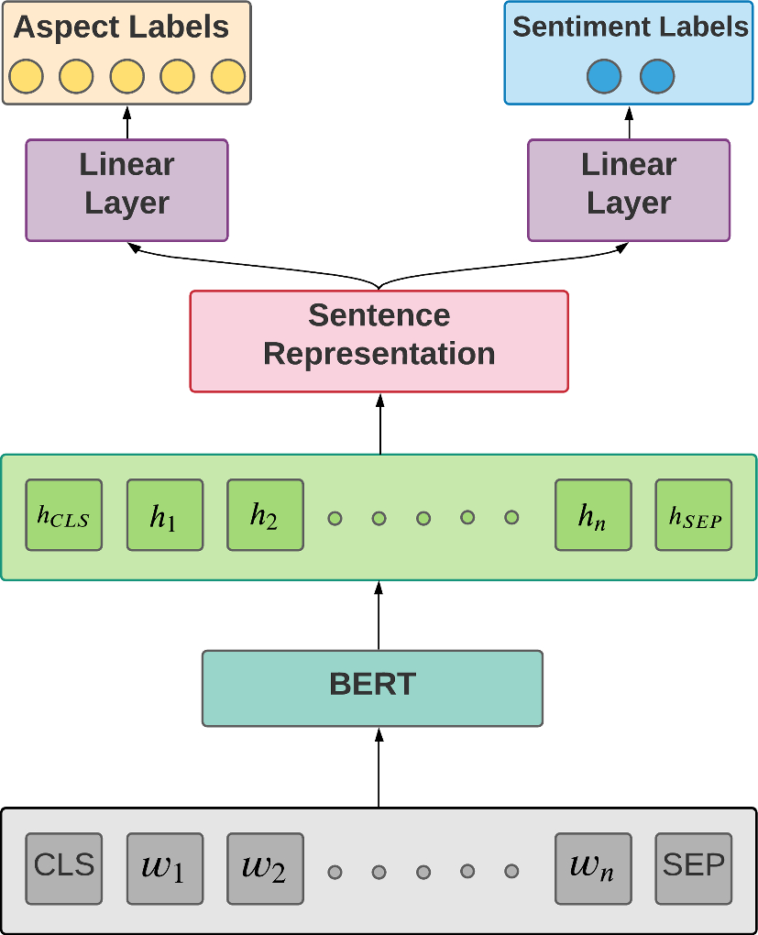
Aspect Based Sentiment Analysis(ABSA) Based on BERT
The ABSA task consists of two sub-tasks, namely,
Aspect Extraction and Aspect Sentiment Classification.
Aspect Extraction
Aspect category detection helps in identifying the generic topics or aspect category (i.e., characteristics of the food or service) discussed in the opinionated text.
Aspect Sentiment Classification
Aspect sentiment classification (ASC) aims to classify the sentiment polarity (positive, negative, or neutral) expressed on an aspect extracted from a review sentence.
There are two inputs to ASC: an aspect and a review sentence mentioning that aspect.

Slide 16
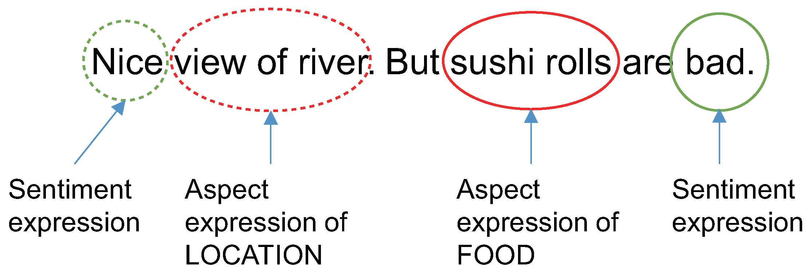
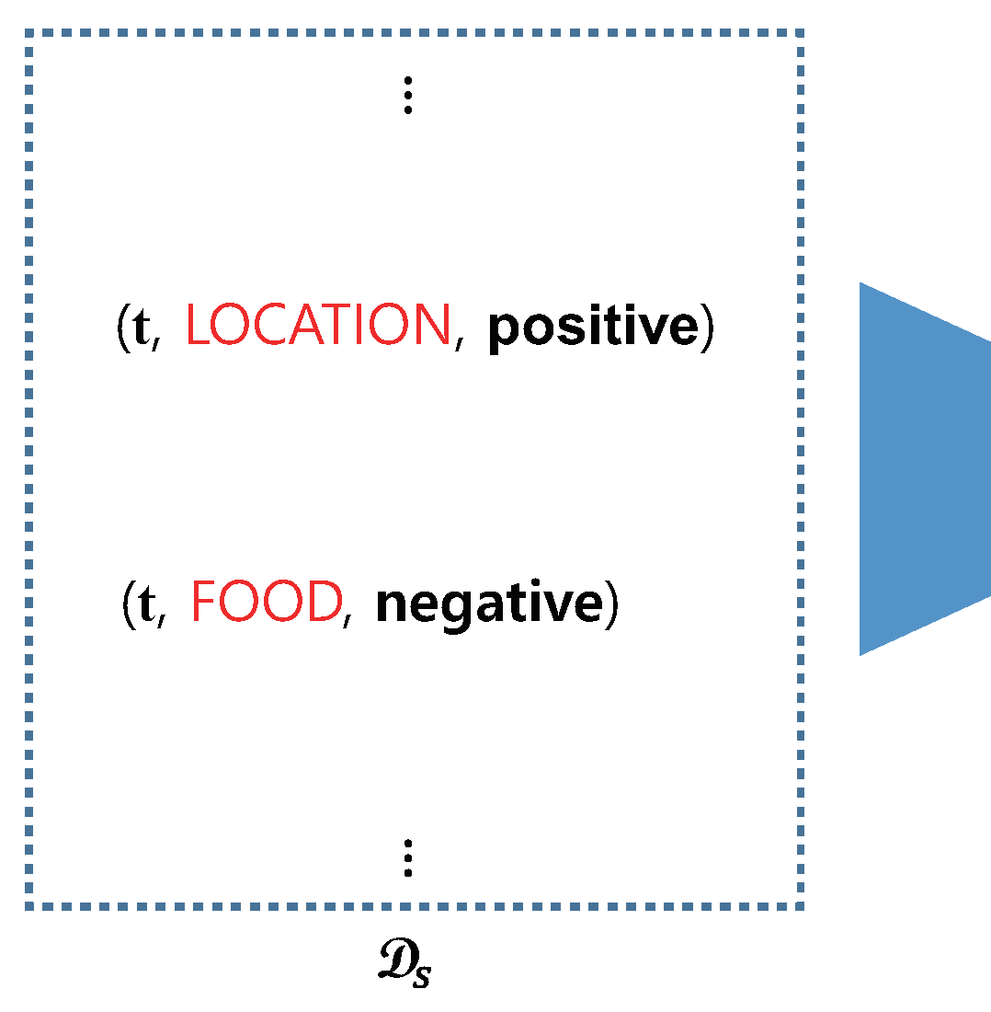
(ABSA) Based on BERT
Example
Model: classifier-rest-0.2
Accuracy: 85.17%

Slide 17
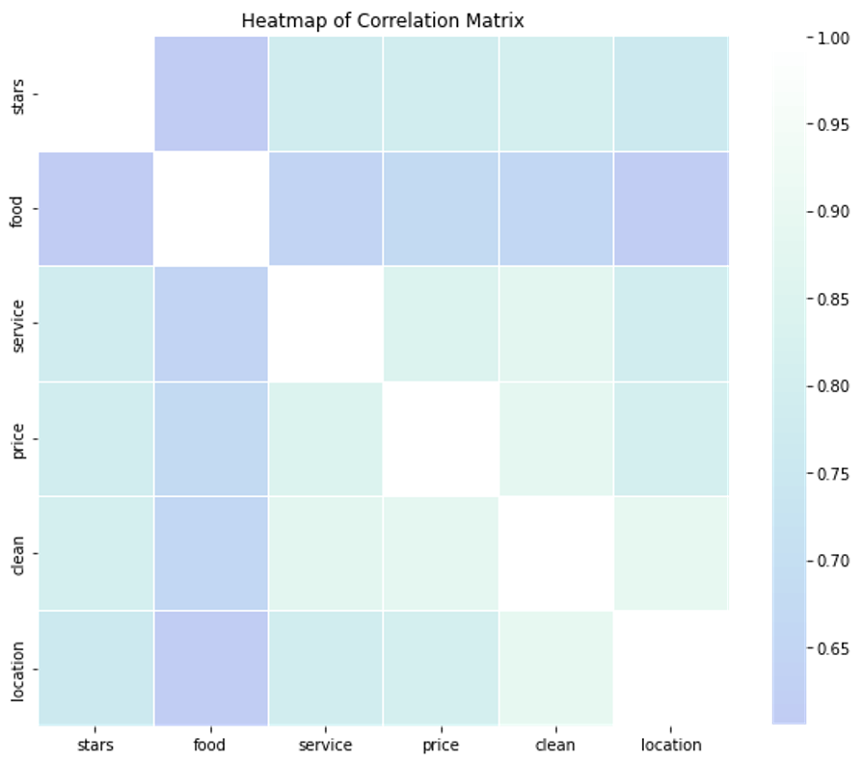
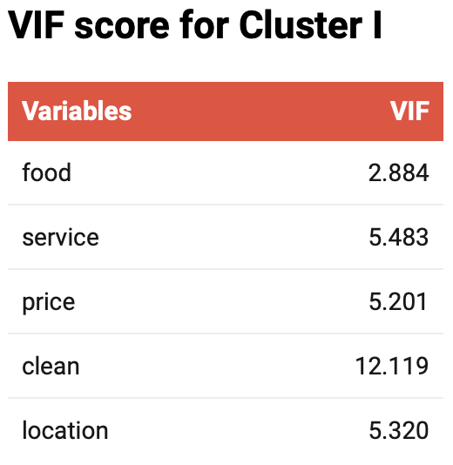
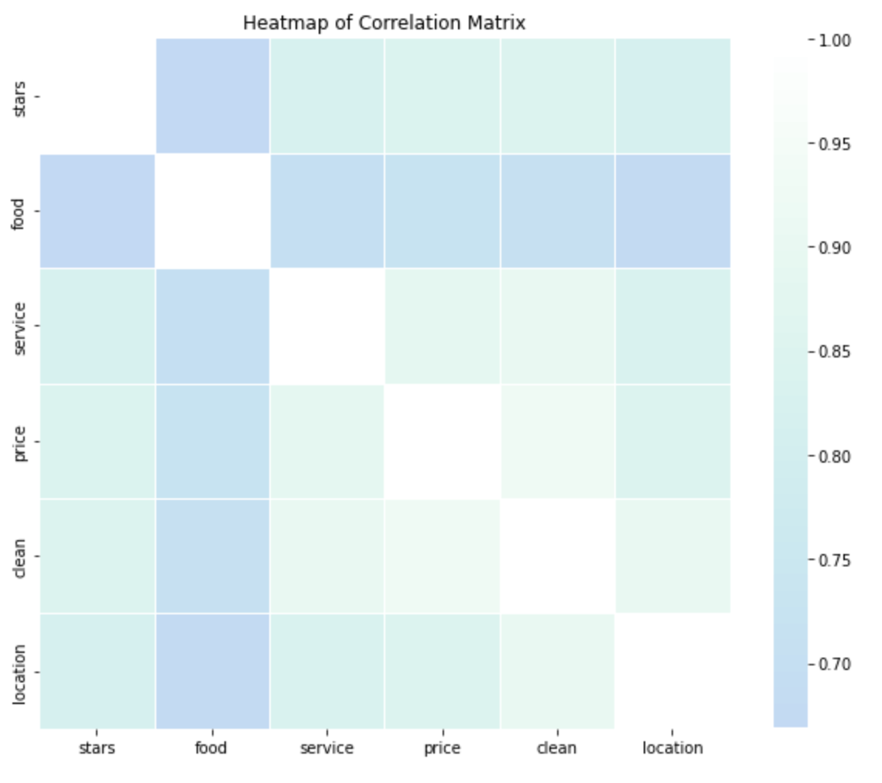
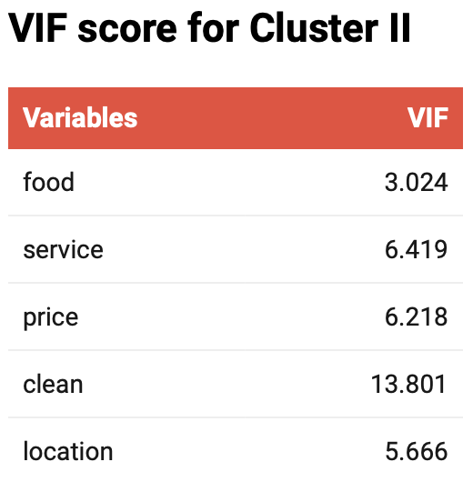
What is the Multicollinearity dataset
Multicollinearity is a statistical concept where several independent variables in a model are correlated. It will generate high variance of the estimated coefficients.
There are two kinds of Multicollinearity, one is Structural Multicollinearity other is Data Multicollinearity.
What will Multicollinearity Cause
Multicollinearity reduces the precision of the estimated coefficients, which will weaken the statistical power of the regression model.

Slide 18
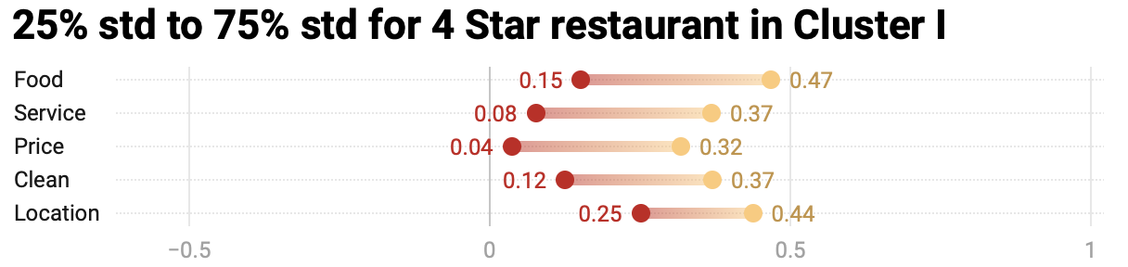
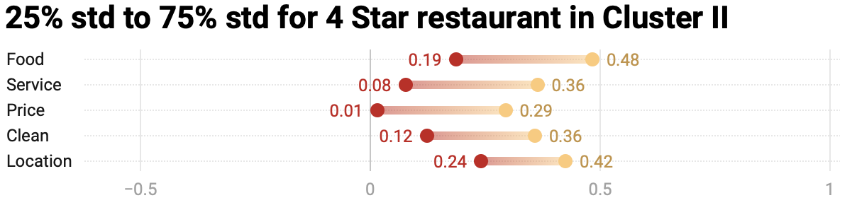
How to handle Multicollinearity
Since Simple Linear Regression model can become very sensitive to small changes in the Dataset.
We also cannot choose to remove or combine the highly correlated independent variables.
SOLUTION ONE:
Perform analysis designed for highly correlated variables, such as Ridge, Lasso, Partial Least Square and Principal Component Regression.
SOLUTION TWO:
Implement a model that makes no assumptions on the relationship between features, like Decision Tree.
Notes:
多次训练coeff不同

Slide 19
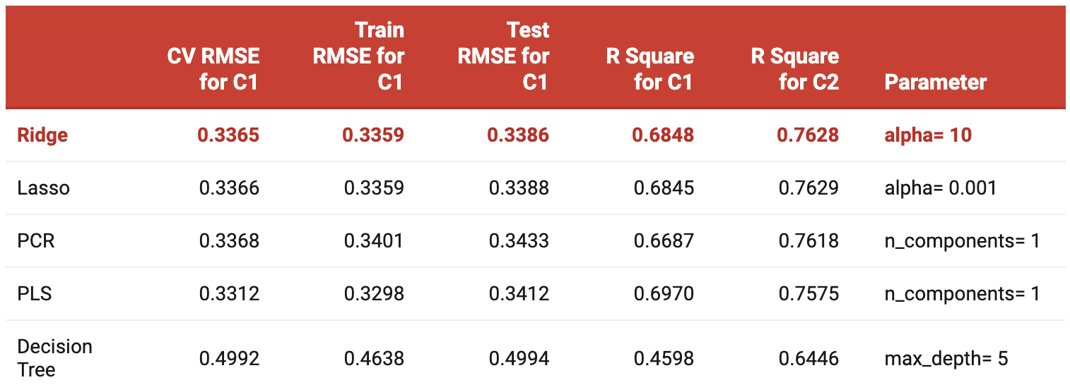
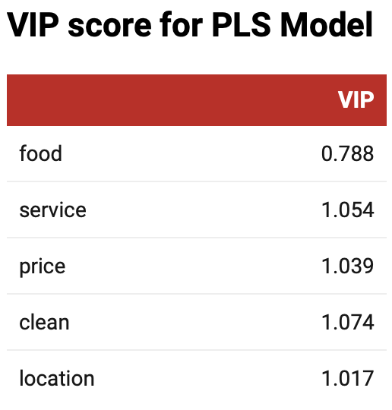
Model Selection - PCR and PLS
By the principle of each model, here we delete the PCR and PLS. PCR and PLS both perform dimensionality reduction, PCR uses PCA to the training data, the transformation is purely unsupervised. PLS is more suitable for a small sample size dataset, which won’t be the best choice here.
Notes:
vip 表格 Variable Importance in Projection (VIP) scores estimate the importance of each variable in the projection used in a PLS model and is often used for variable selection. A variable with a VIP Score close to or greater than 1 (one) can be considered important in given model.
From the comparison table we can see that Ridge, Lasso, PCR and PLS share the similar RMSE and R Square value, it is hard to conclude that the miniment of RMSE and maximum of R-square value will be the best model.

Slide 20
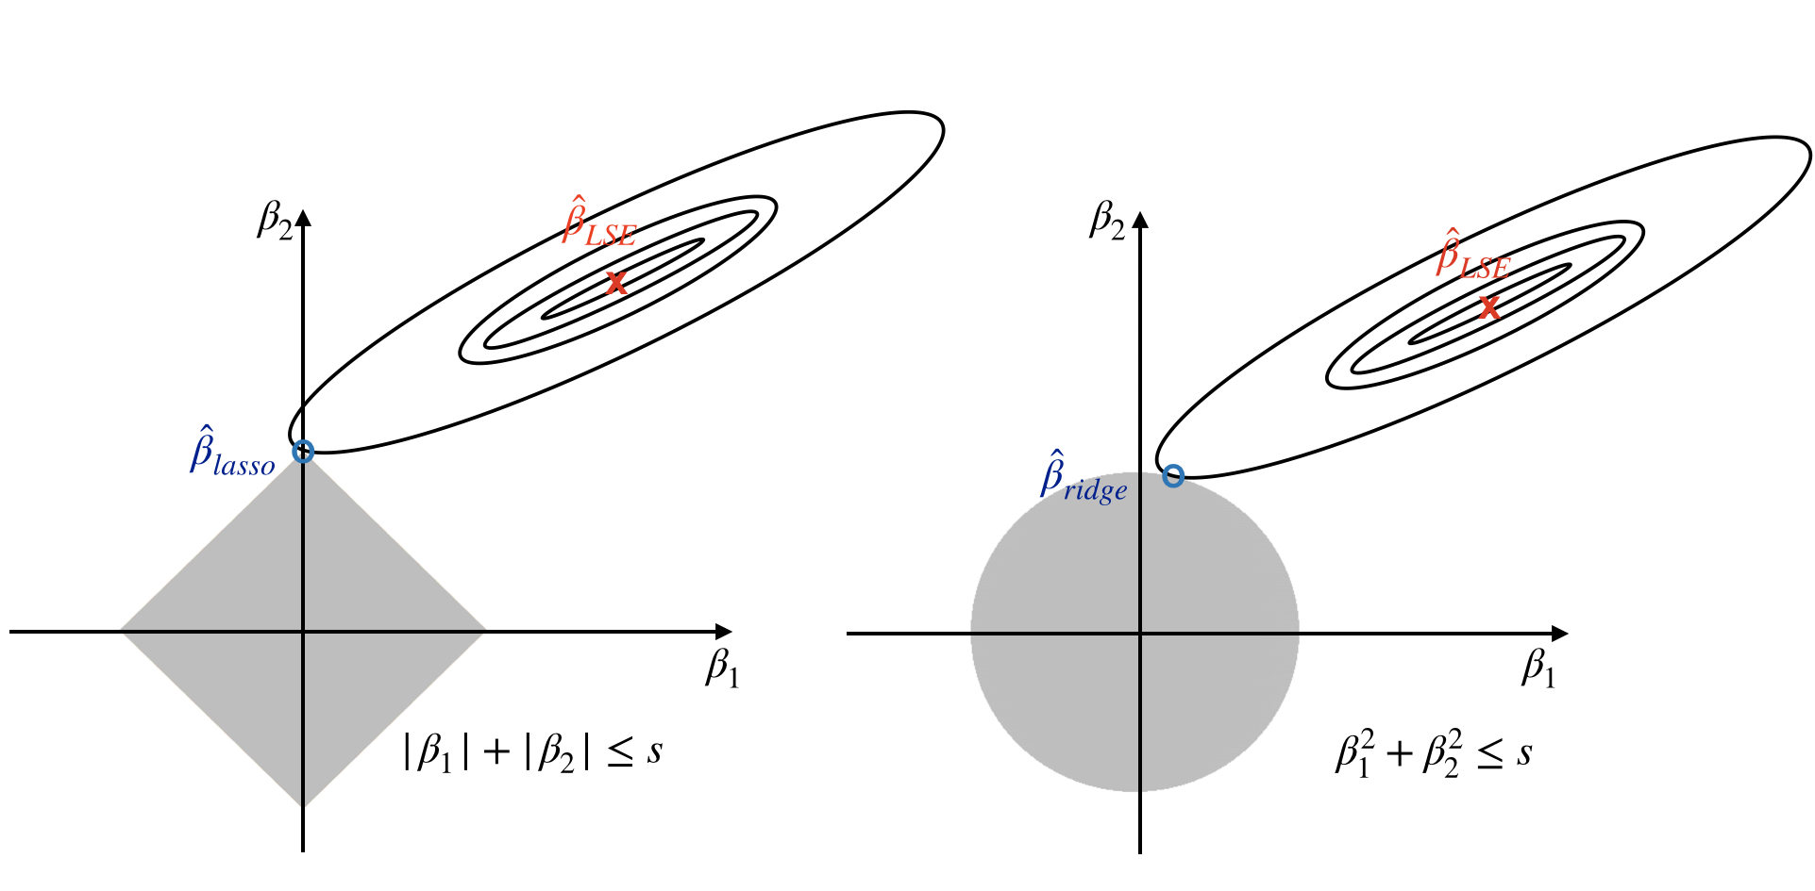
Model Selection - Ridge and Lasso
Both Ridge and Lasso add the penalty parameter alpha to center and scale the predictors. However, Ridge regression shrinks the parameter estimates but it won’t shrink any estimates to be exactly 0. In order to choose the variable, Lasso will shrink some parameters to exactly 0 which make it become a more popular way.

Slide 21
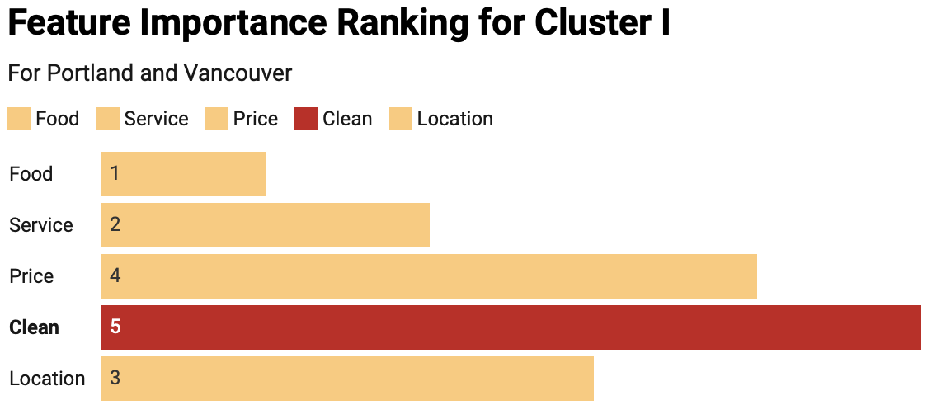
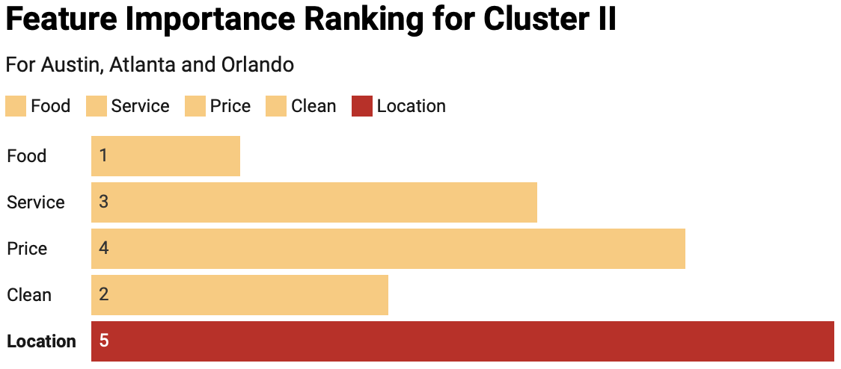
For the cluster one, resident who lived in Portland and Vancouver consider CLEAN as the most important aspect.
For the cluster two, resident who lived in Austin, Atlanta and Orlando consider LOCATION as the most important aspect.

Slide 22
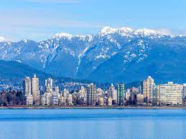

Conclusions
1
Restaurants located geographically close are likely to appear in the same cluster
People living close to each other may share preferences in the taste and styles of restaurants.
2
The difference in the number of reviews for different restaurants is striking
There are only 3 restaurants have more than 7000 reviews with the most one 9185, but there are 472 restaurants have only 5 reviews. The average number of reviews is around 142.
3
‘Food’ has the most limited influence on star compared with other four aspects
‘This may because nowadays people are paying more attention to other aspects such as location, service and cleanliness than food.
4
Customers in Portland & Vancouver are most picky about care about ‘clean’ (cleanliness) of restaurants
5
Customers in Atlanta & Orlando & Austin are likely to choose restaurants with good ‘location’.
Clean
Location
Notes:
According to business data clustering, restaurants in Portland and Vancouver make up the bulk of one cluster. Same for the other three cities.

Slide 23




Limitation and Future Work
ABSA model accuracy can be improved:
Fed with more training data with sentiment labels on our newly selected aspects, the accuracy of sentiment classification on that aspect of ABSA model can be improved.
Add more data to the model:
Due to limitation of computing power (especially in the process of ABSA), we filtered data by selecting top cities and selected reviews through stratified sampling to reduce data volume. The model may be more robust with more reviews from more areas.
Explore new trends after COVID-19:
The reviews data extracted mainly range from 2010 for 2020, where post-COVID-19 data accounts for a small proportion. Considering social and economic changes after pandemic, it is of great value to explore new post-COVID trends.
Application in consumer experience for businesses:
Our model can be included in a more advanced marketing analytics system to draw insights from consumer comments and convert them into guidelines for the business companies.
Notes:
For example, a consumer brand on Instagram can use our model to analyze people's comments to better understand which aspect of its product needs further improvement.

Slide 24
References
https://aclanthology.org/N19-1242.pdf
https://github.com/ScalaConsultants/Aspect-Based-Sentiment-Analysis
https://link.springer.com/article/10.1007/s11063-021-10596-6
https://www.mdpi.com/2076-3417/9/16/3239/htm
https://datascience.stackexchange.com/questions/31402/multicollinearity-in-decision-tree
Peri C (2006). The universe of food quality. Food Qual. Prefer., 17(1-2): 3-8.
Jamal A, Anastasiadou K (2009). Investigating the effects of service quality dimensions and expertise on loyalty. Eur. J. Mark., 43(3): 398- 420
Kim WG, Lee YK, Yoo YJ (2006). Predictors of relationship quality and relationship outcomes in luxury restaurants. J. Hosp. Tour. Res., 30(2): 143-169
Hyun SS (2010). Predictors of relationship quality and loyalty in the chain restaurant industry. Cornell Hosp. Q., 51(2): 251-267.
https://towardsdatascience.com/ridge-and-lasso-regression-a-complete-guide-with-python-scikit-learn-e20e34bcbf0b
https://stats.stackexchange.com/questions/108614/regression-in-pn-setting-how-to-choose-regularization-method-lasso-pls-pc
https://en.wikipedia.org/wiki/Principal_component_regression
https://en.wikipedia.org/wiki/Partial_least_squares_regression
https://scikit-learn.org/stable/modules/clustering.html#
https://statisticsbyjim.com/regression/multicollinearity-in-regression-analysis/#:~:text=Multicollinearity%20reduces%20the%20precision%20of,variables%20that%20are%20statistically%20significant.
https://scientistcafe.com/ids/ridge-regression.html

Slide 25
Q & A

Slide 26
Appendix

Slide 27
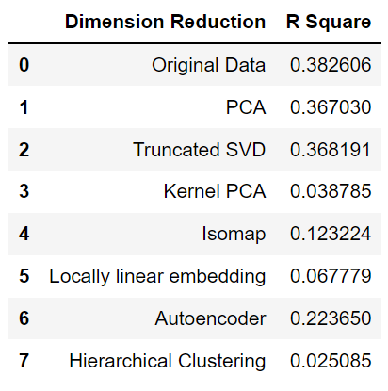
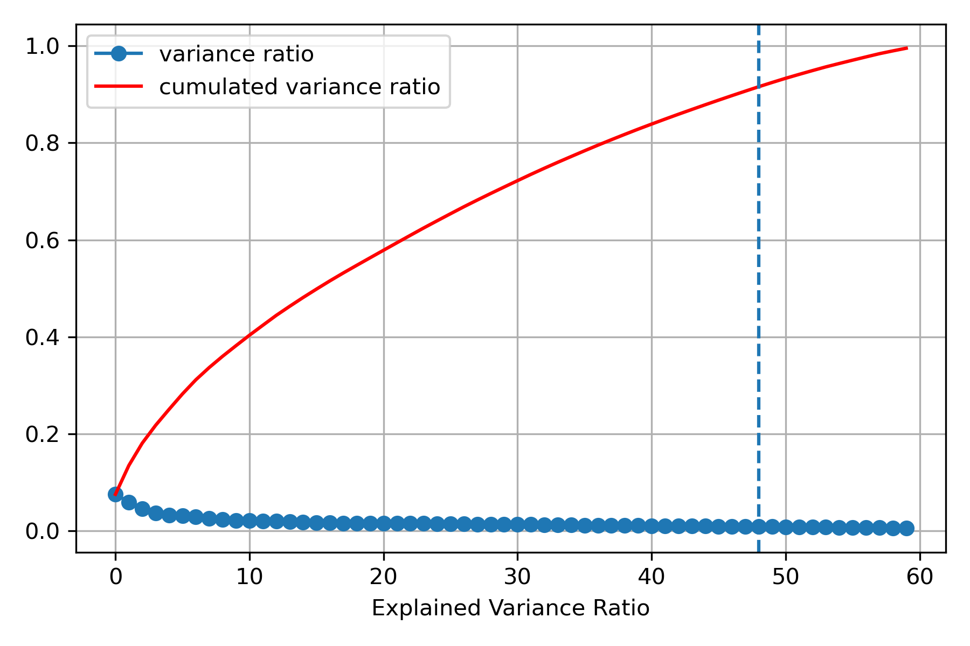
Dimension reduction comparison

Slide 28
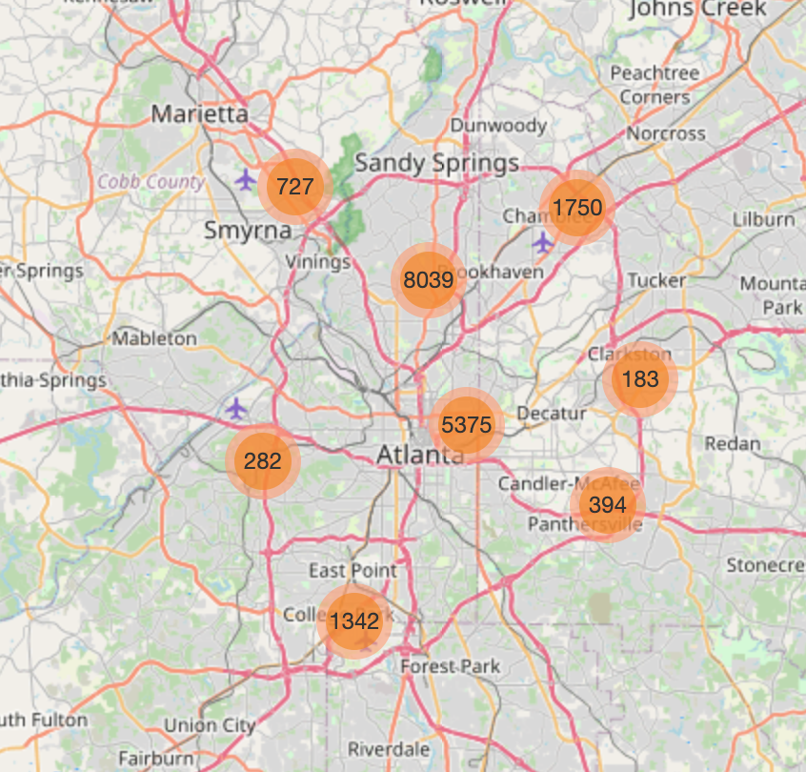
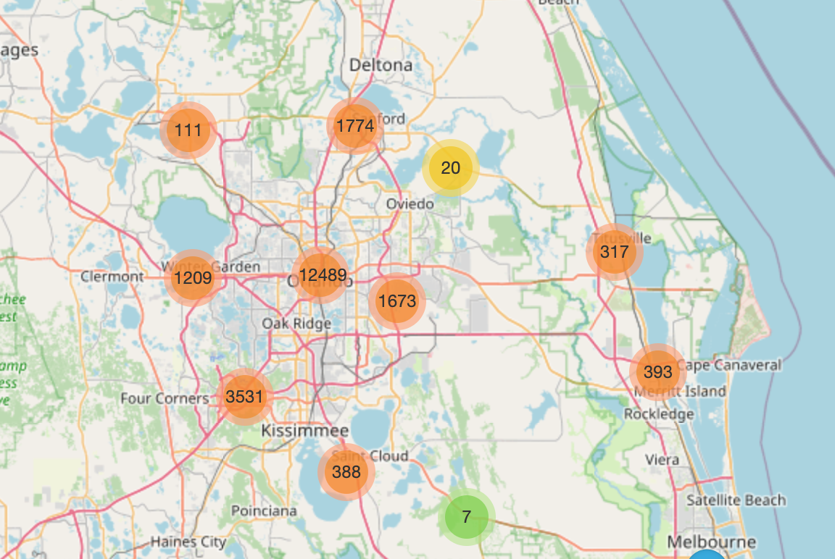
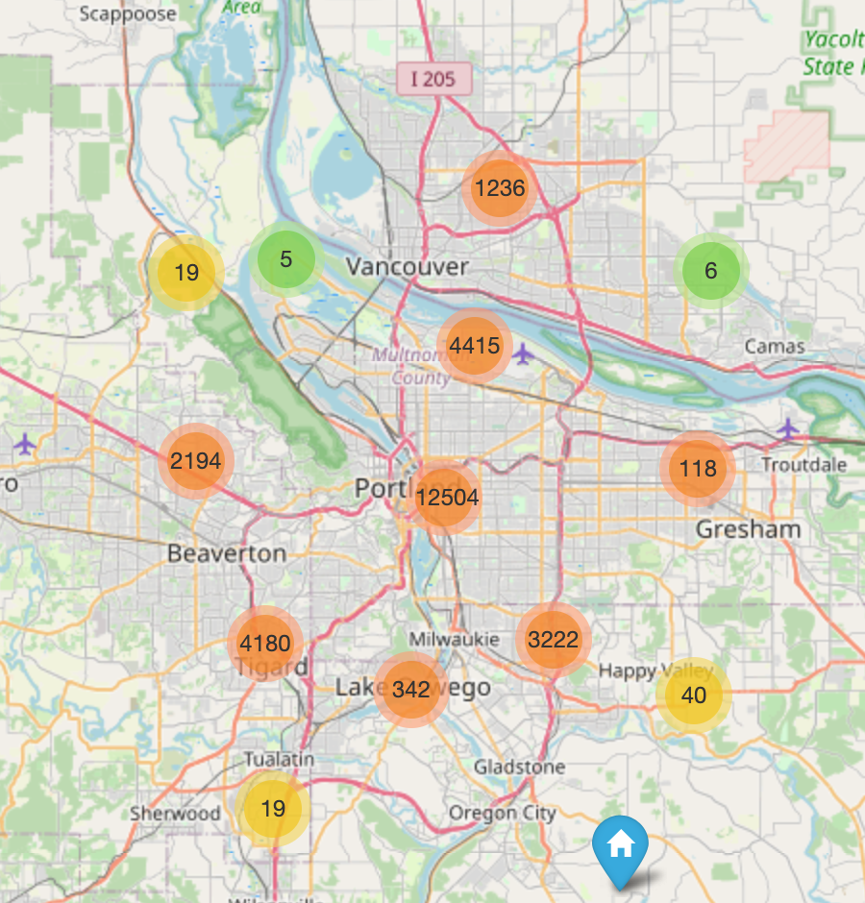
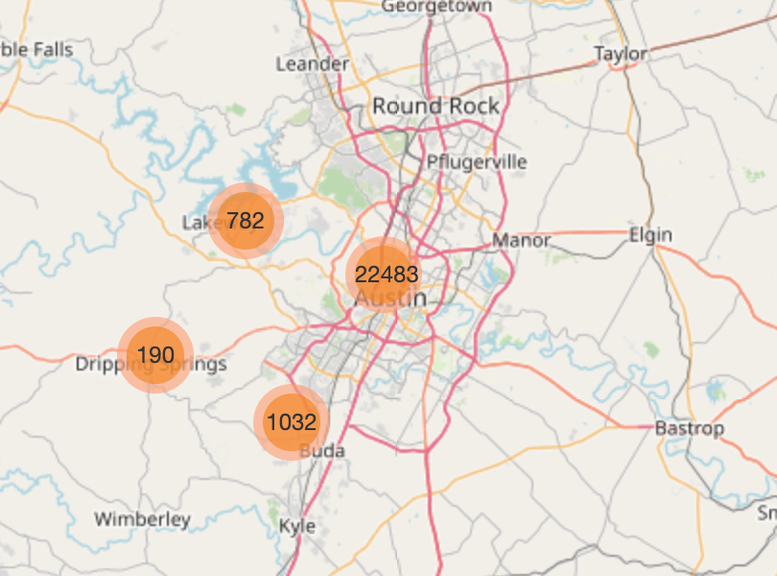

Slide 29
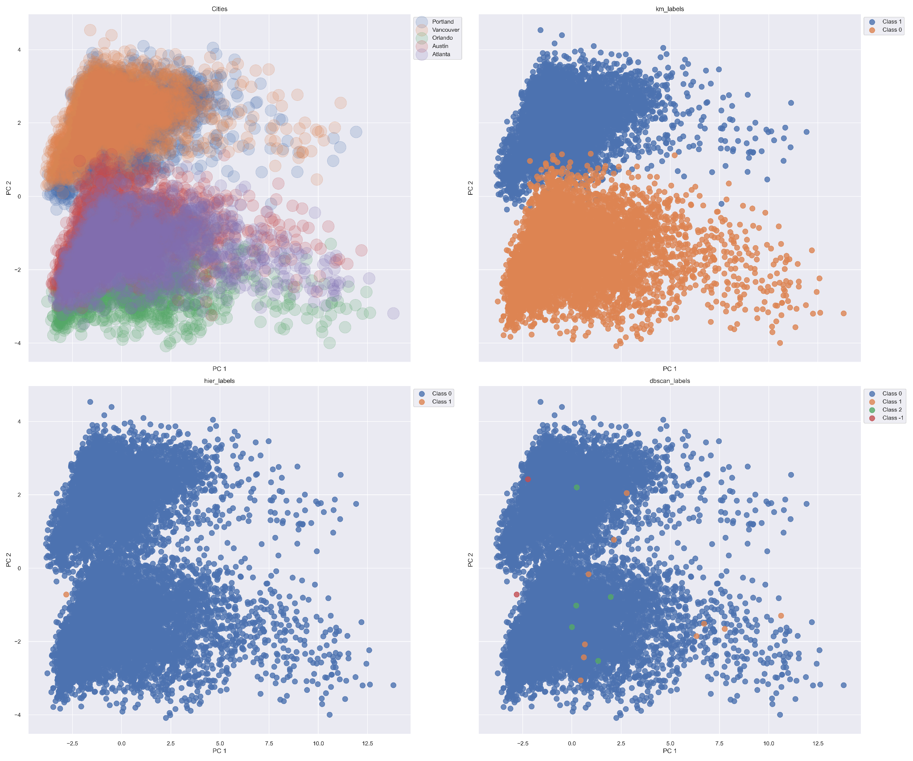
Agglomerative
DBSCAN
Not require the pre-defined number of clusters as parameter
Clustering result highly depend on “eps”(neighborhood radius) and “min_samples”(how popular should core samples be)
Need to define number of clusters ahead
Bottom-up: each observation starts in its own cluster, successively merge together
Clustering result depends on chosen linkage criteria, since it determines which two clusters are merged

Slide 30
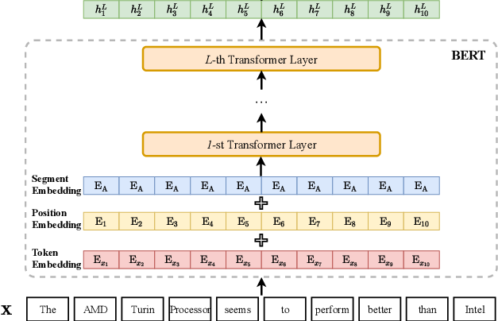
Bidirectional Encoder Representations from Transformers (BERT)
Word embedding is used for the representation of words.
A transformer is a deep learning model that adopts the mechanism of self-attention, differentially weighting the significance of each part of the input data.
BERT input sequence are the sum of the token embeddings, segment embeddings, and positional embeddings.

Slide 31
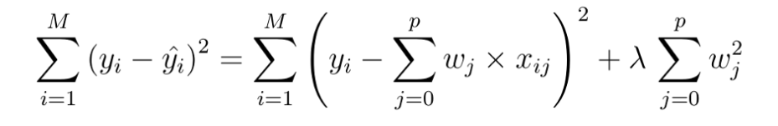
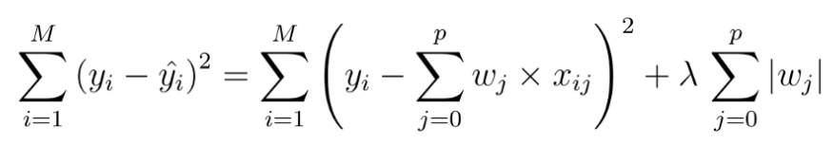
Introduction of 4 Regression Models
Ridge vs Lasso (least absolute shrinkage and selection operator)
They are both methods of estimating the coefficients of multiple-regression models in scenarios where linearly independent variables are highly correlated. The main difference between the two models is their cost functions. Lasso’s regularization (L1) can lead to zero coefficients, so Lasso can also help in feature selection.
Ridge Regression Cost Function
Lasso Regression Cost Function
PCR vs PLS
In statistics, principal component regression (PCR) is a regression analysis technique that is based on principal component analysis (PCA). More specifically, PCR is used for estimating the unknown regression coefficients in a standard linear regression model.
Partial least squares regression (PLS regression) is a statistical method that bears some relation to principal components regression; instead of finding hyperplanes of maximum variance between the response and independent variables, it finds a linear regression model by projecting the predicted variables and the observable variables to a new space.
Principle Components of PCR
Principle Components of PLS
Only constructed based on X
Constructed based on both X and Y
Notes:
Ridge regression is a method of estimating the coefficients of multiple-regression models in scenarios where linearly independent variables are highly correlated.
lasso (least absolute shrinkage and selection operator; also Lasso or LASSO) is a regression analysis method that performs both variable selection and regularization in order to enhance the prediction accuracy and interpretability of the resulting statistical model. Just like Ridge regression cost function, for lambda =0, the equation above reduces to equation 1.2. The only difference is instead of taking the square of the coefficients, magnitudes are taken into account. This type of regularization (L1) can lead to zero coefficients i.e. some of the features are completely neglected for the evaluation of output. So Lasso regression not only helps in reducing over-fitting but it can help us in feature selection.
PCR is very similar to ridge regression: both methods use the principal components of the input matrix XX. Ridge regression shrinks the coeﬃcients of the principal components, the shrinkage depends on the corresponding eigenvalues; PCR completely discards the components to the smallest p−q eigenvalues.
PLS also constructs a set of linear combinations of the inputs for regression, but unlike principal components regression it uses yy in addition to XX for this construction Since it uses also y to determine the PLS-directions, this method is supposed to have better prediction performance than for instance PCR. In contrast to PCR, PLS is looking for directions with high variance and large correlation with yy.

Slide 32
